Slide 1
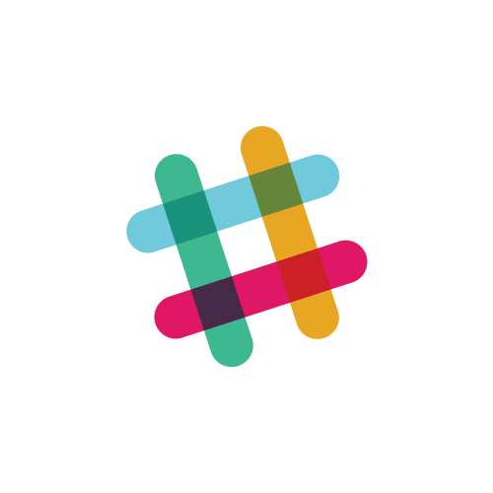
Bot Chat: Creating your first Slack bot
Brice McIver
Keyhole Software
August 4, 2017

Slide 2
Outline
Background
Setup
Post messages (incoming webhooks)
Event Subscriptions
Slack Developer Kit for Node.js
Easier solutions :-)

Slide 3

Background
Launched in August 2013
Started as an internal tool for collaboration
Original backend was an IRC server
Notes:
Switch to IBM clip, queued up

Slide 4

Success
Over 3 million users each work day
Reached $1 billion valuation in 15 months
Notes:
Switch to Slack intro video, queued up

Slide 5
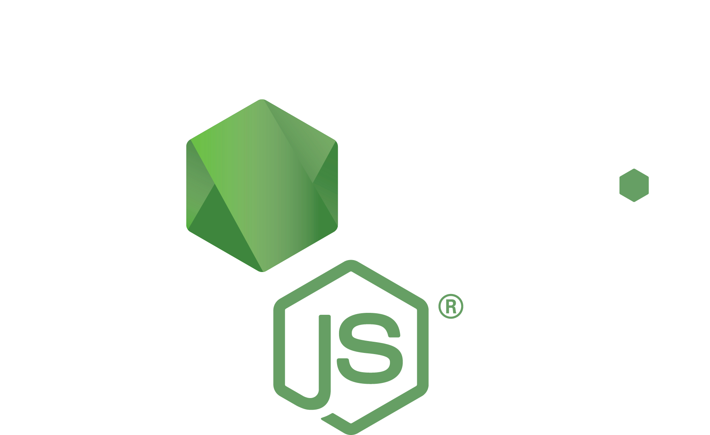


Prerequisites
NodeJS
IDE
Browser / Testing tool

Slide 6
Basic Node Express App
Notes:
Switch to Show npm init video

Slide 7
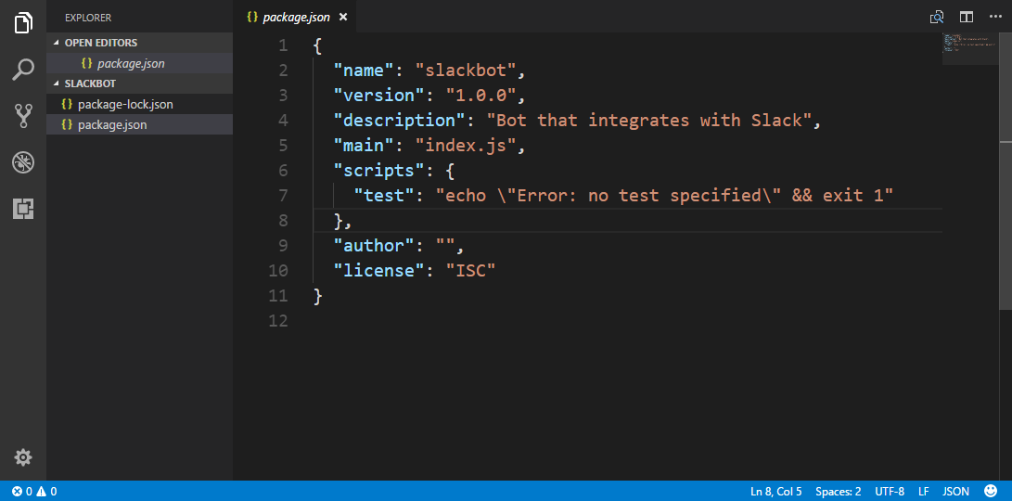

Slide 8
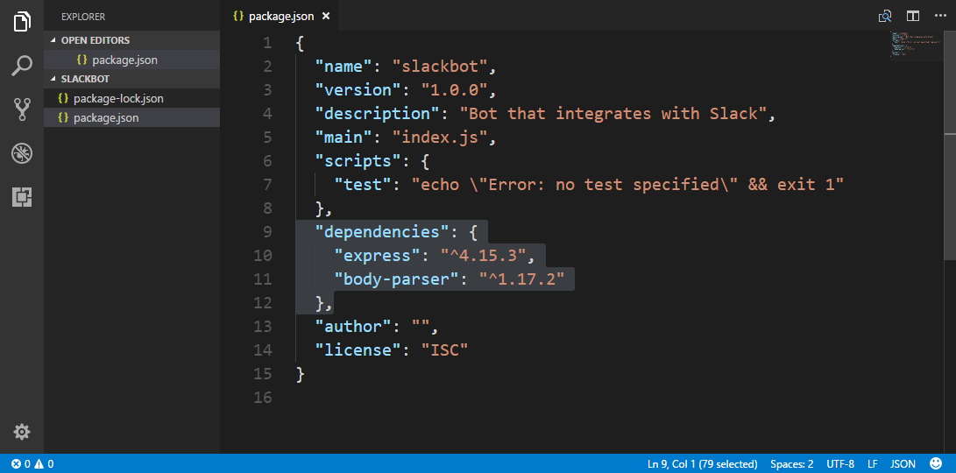

Slide 9
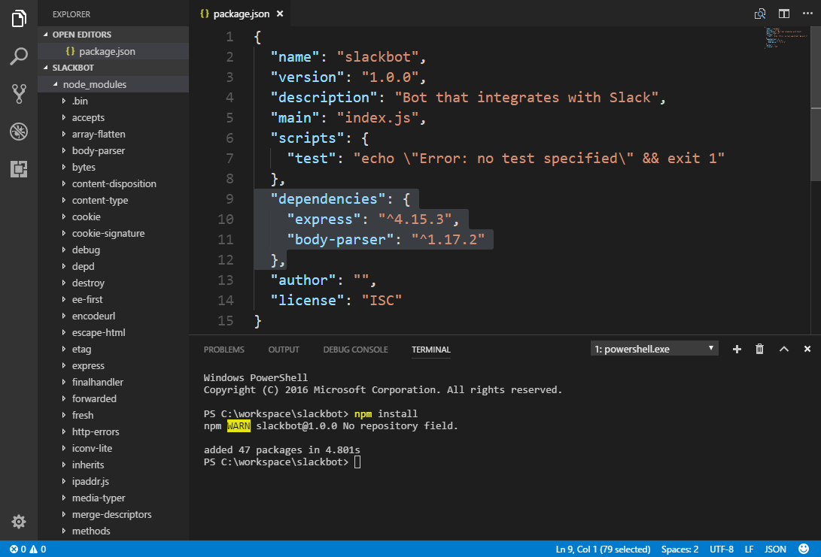

Slide 10
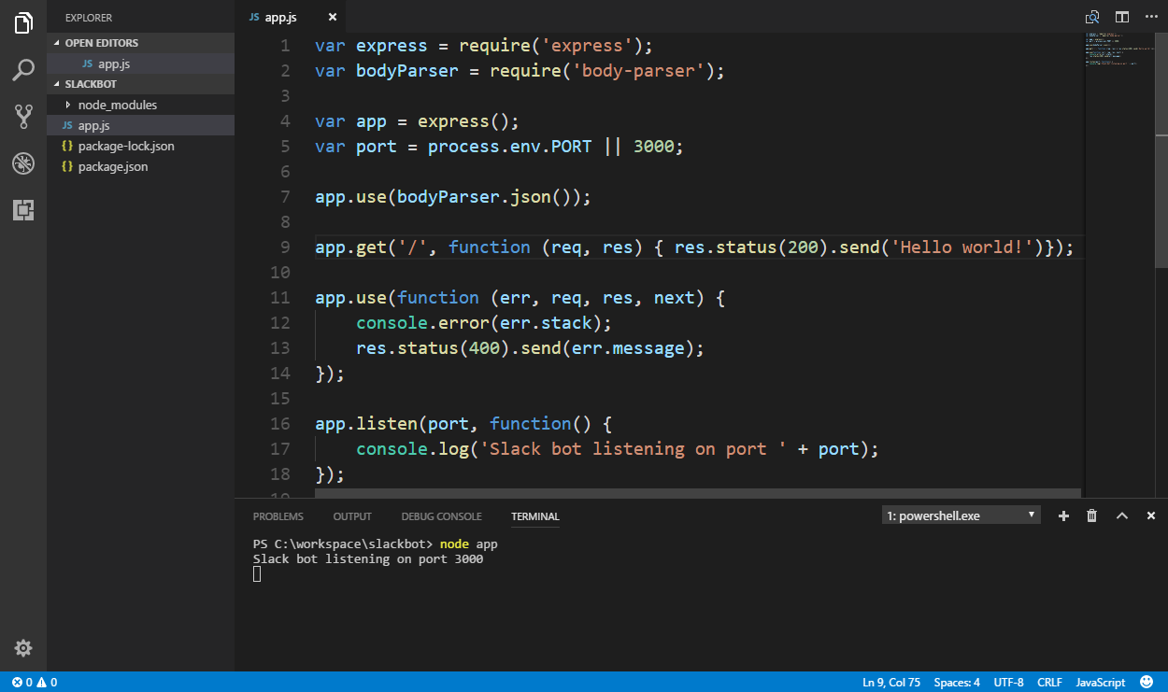

Slide 11
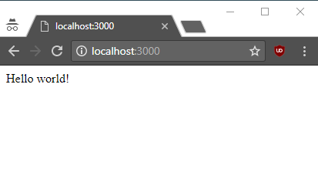

Slide 12
Post Messages Using Incoming Webhooks
Notes:
Start video on slack signup

Slide 13
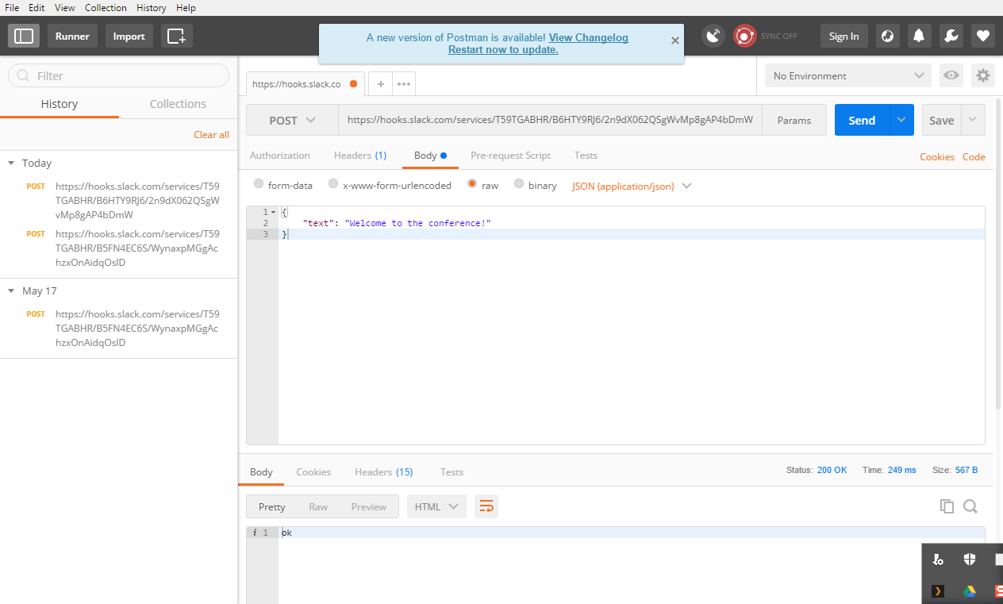

Slide 14
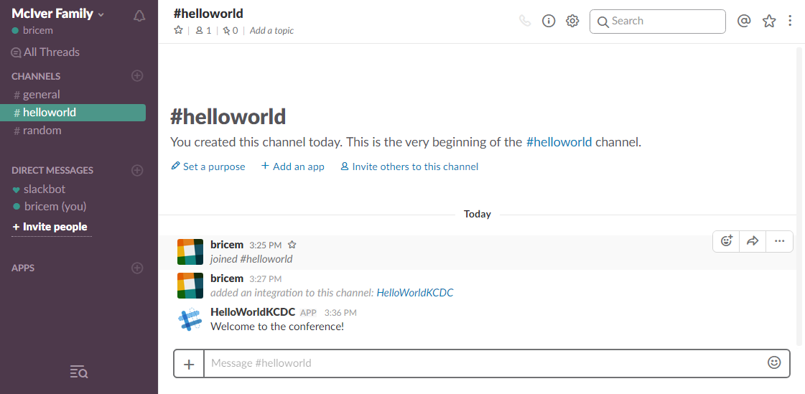

Slide 15
Event Subscriptions
Notes:
Switch to event subscription video

Slide 16
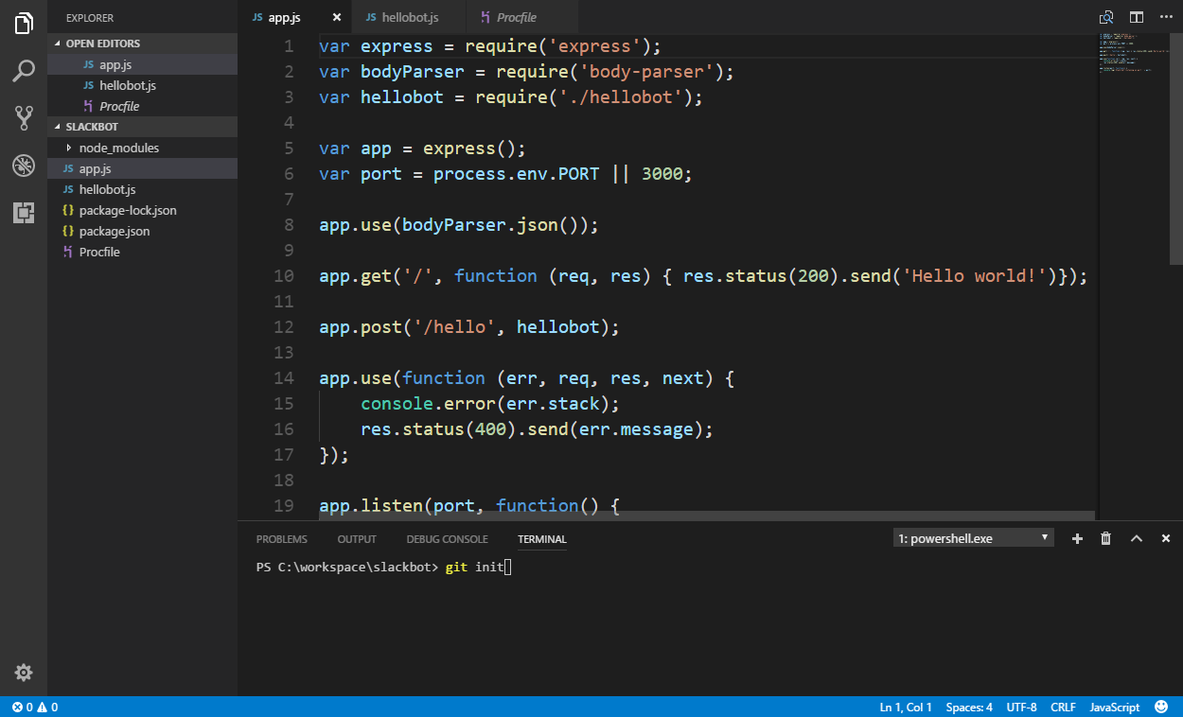

Slide 17
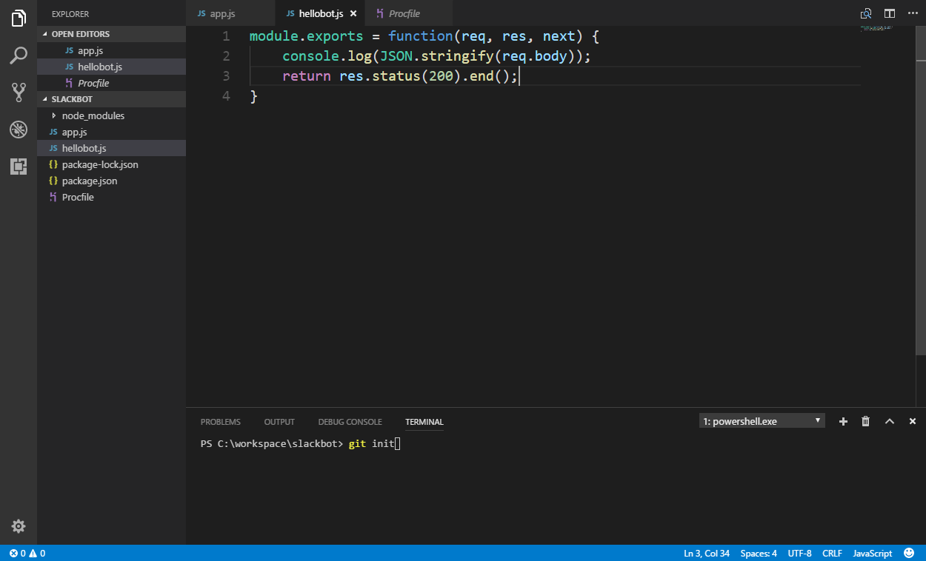

Slide 18
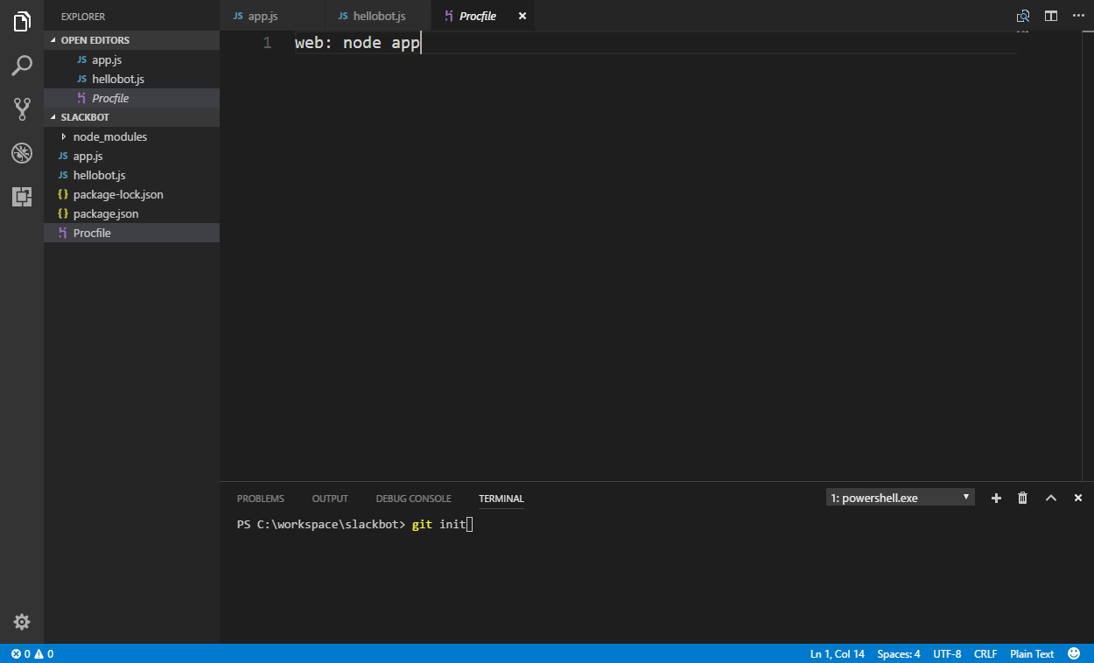

Slide 19
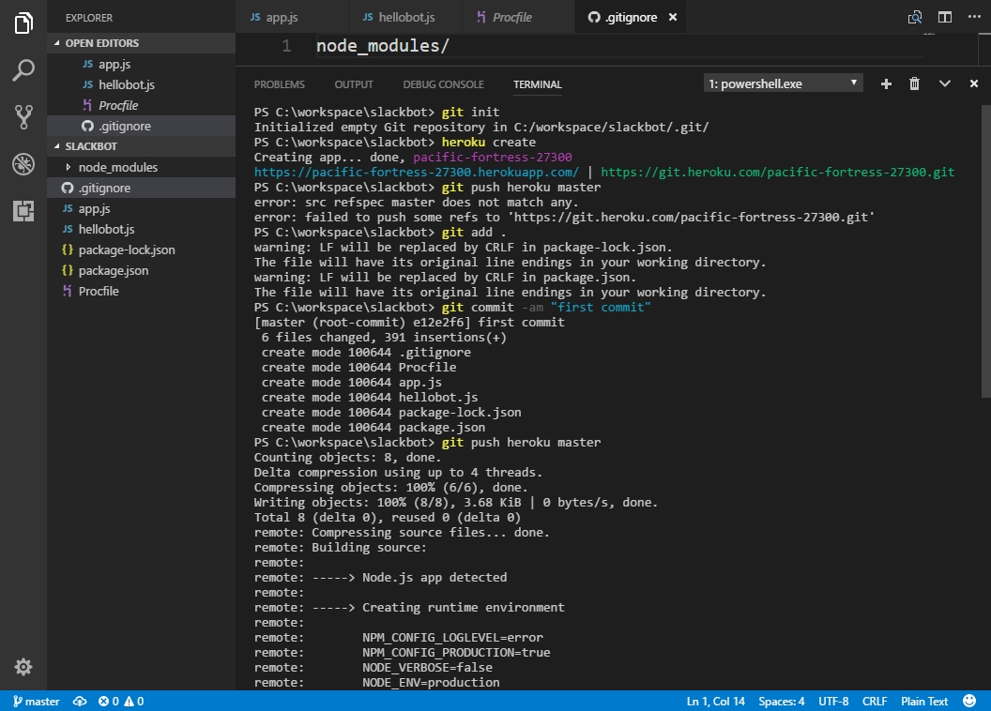

Slide 20
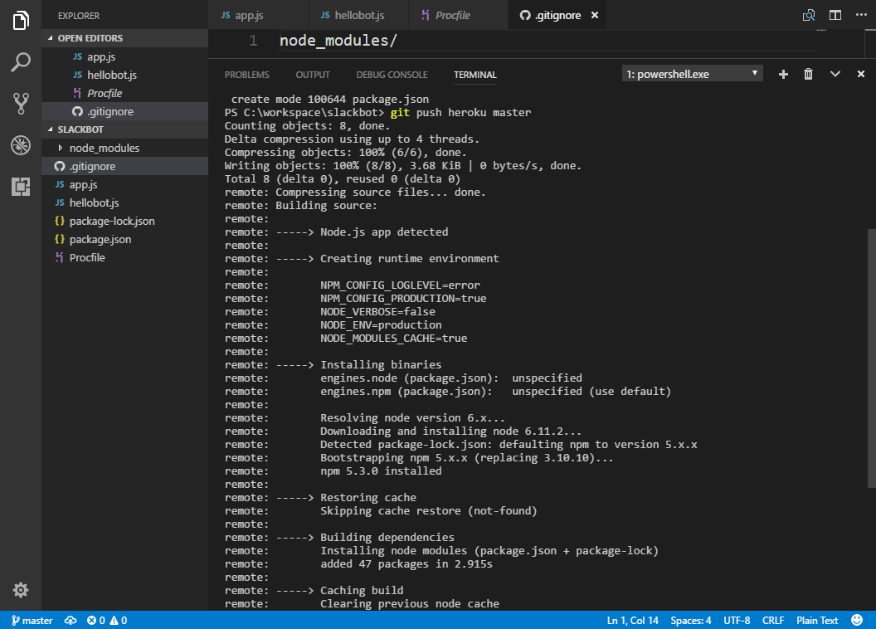

Slide 21
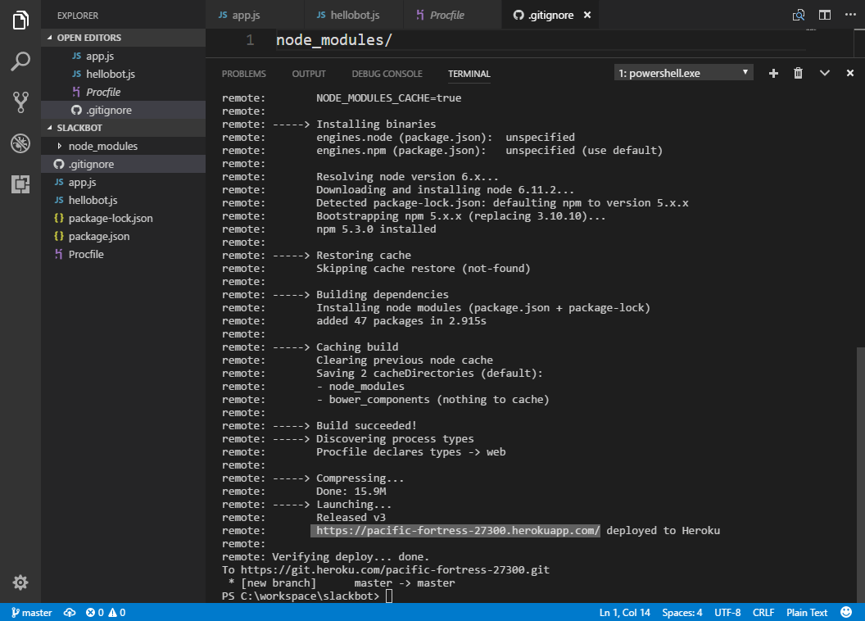
Notes:
Next play challenge1 clip

Slide 22
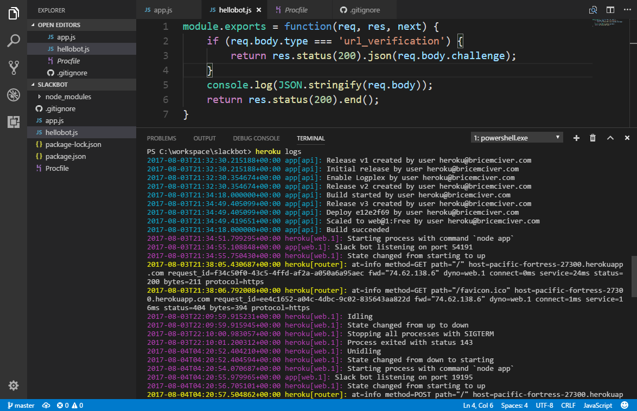

Slide 23
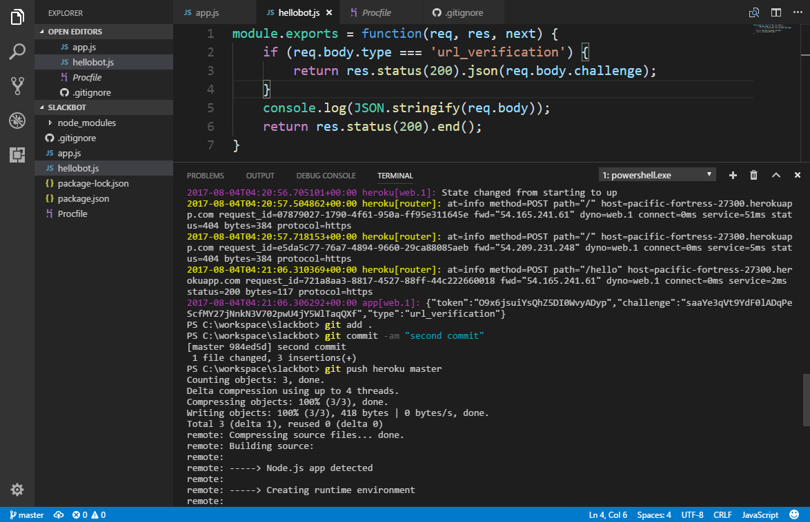

Slide 24
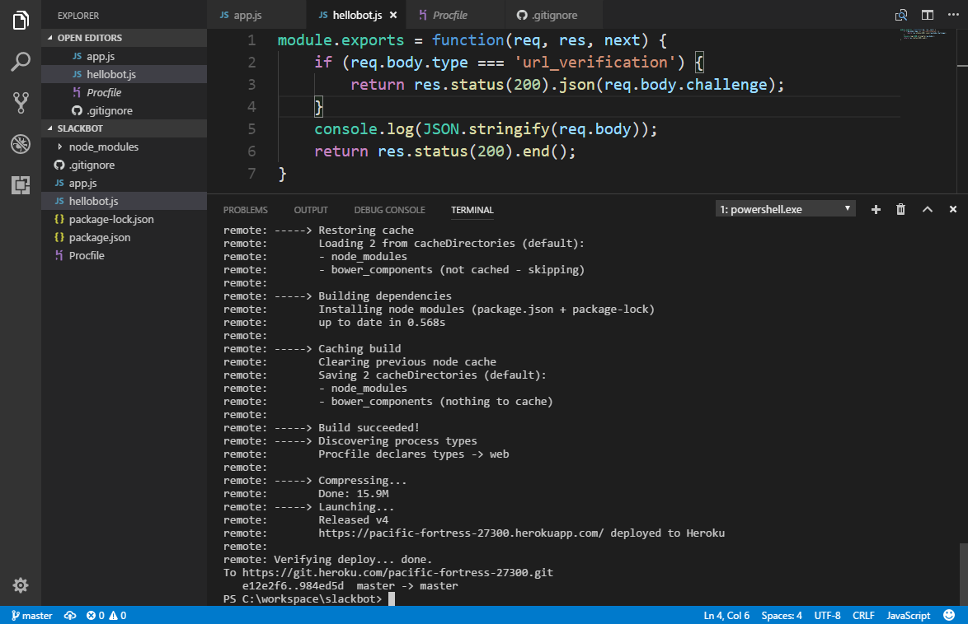
Notes:
Play challenge 2 clip followed by leave join 1

Slide 25
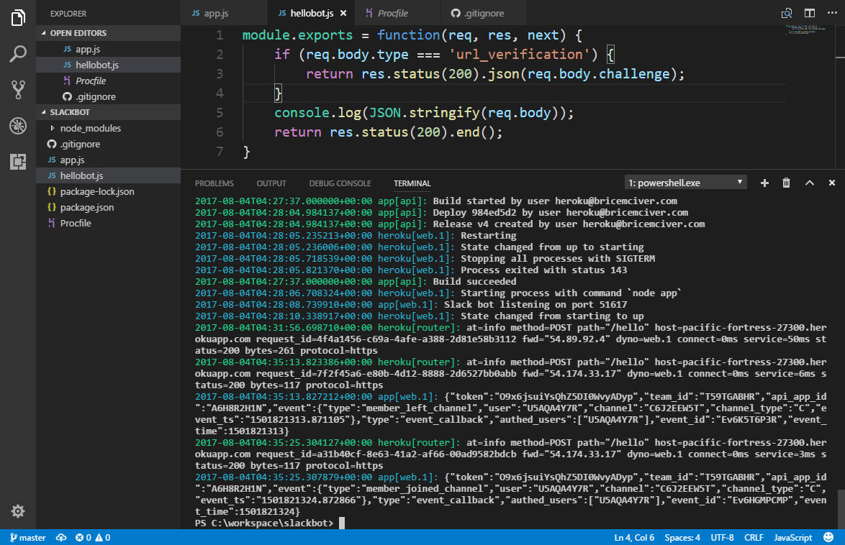

Slide 26
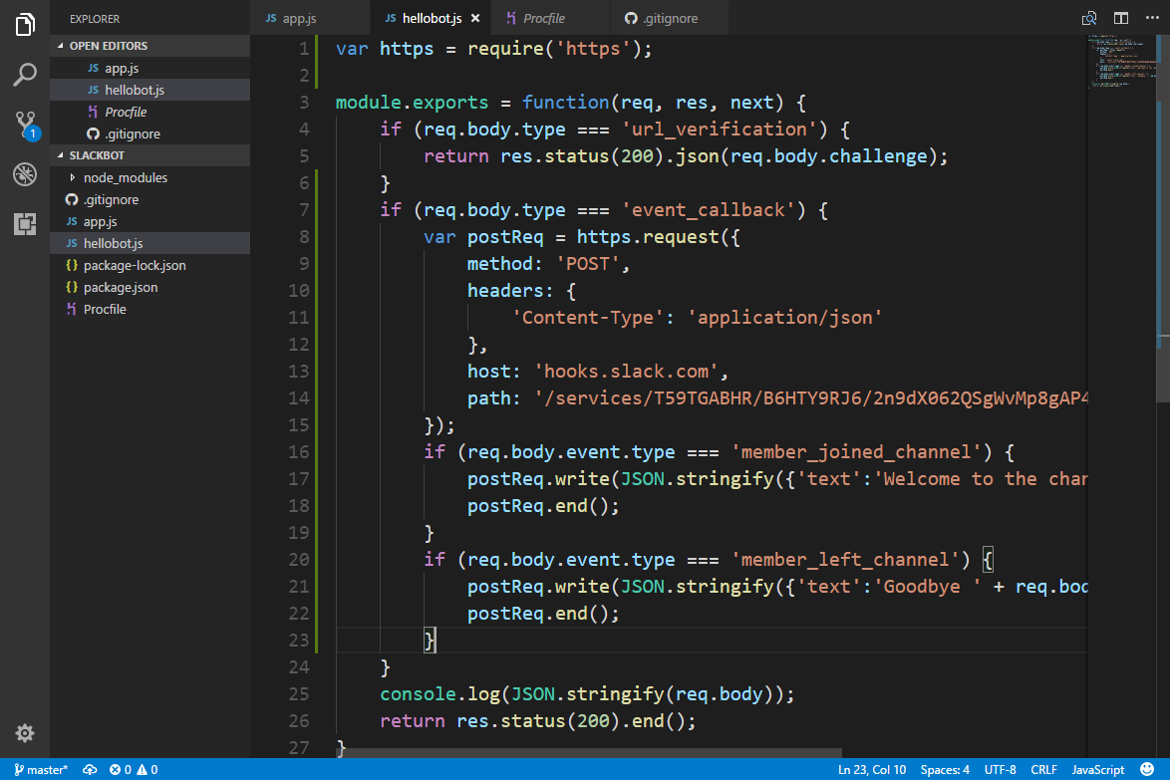

Slide 27
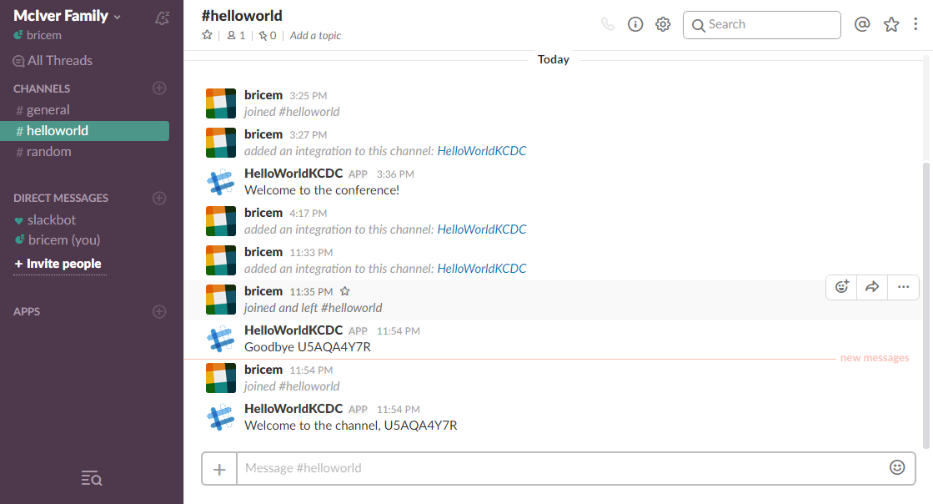

Slide 28
Slack Developer Kit

Slide 29
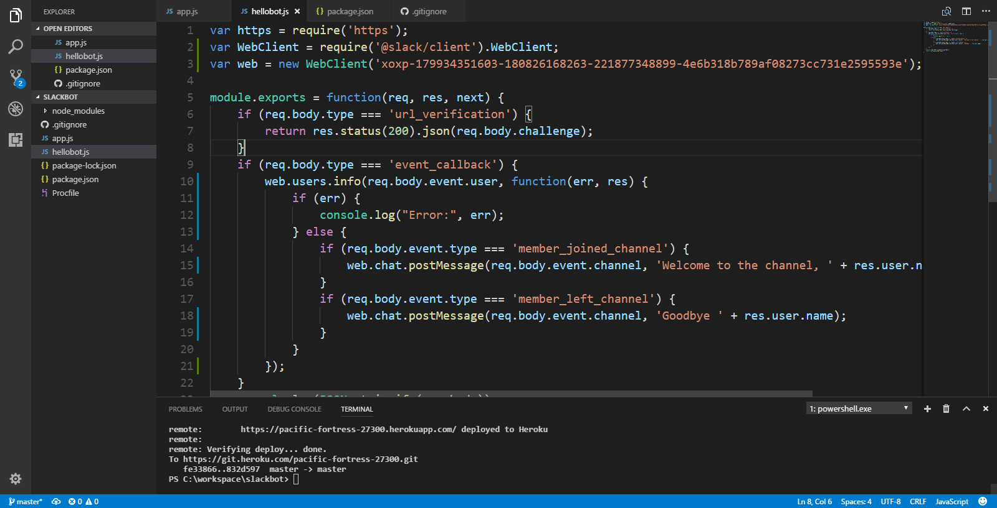

Slide 30
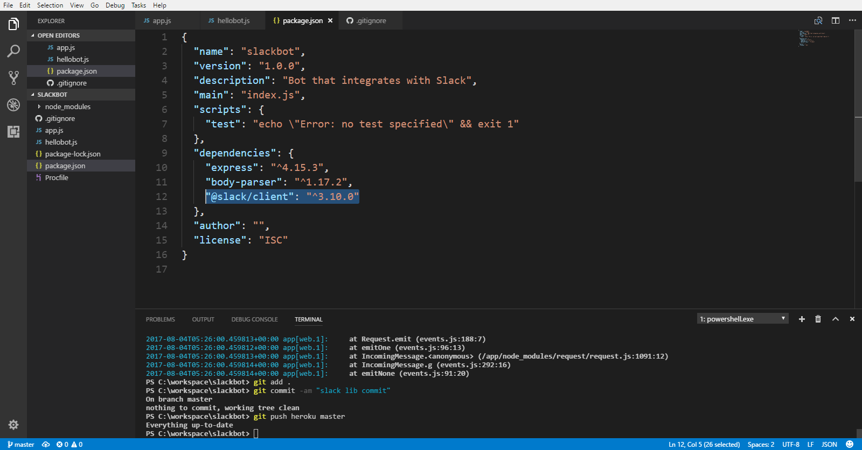

Slide 31
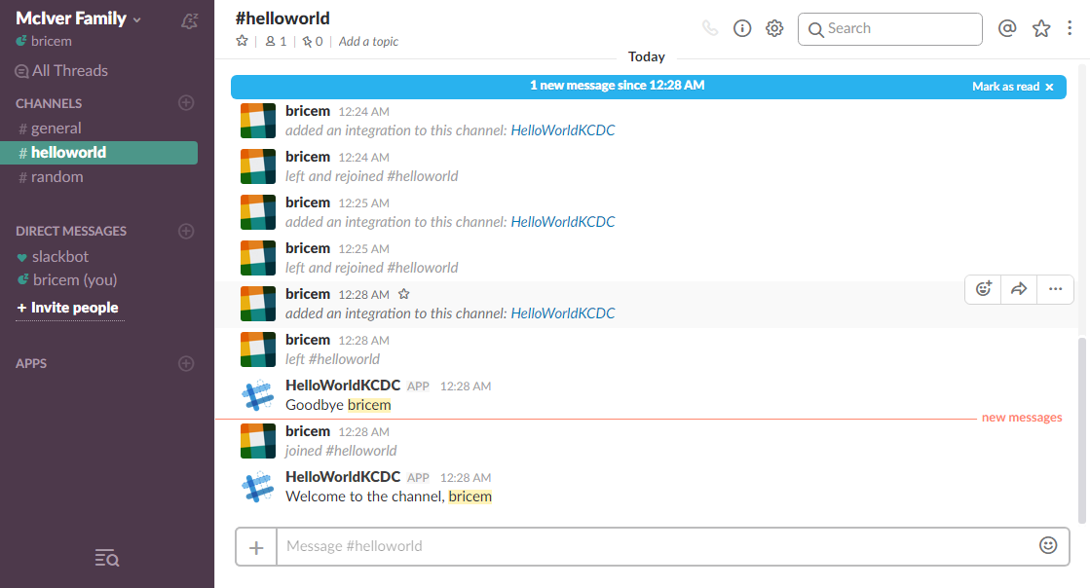

Slide 32
Easier Solutions

Slide 33
Bot Libraries
Howdy’s BotKit
Microsoft Bot Framework
Gupshup
API.AI
Wit.ai
Visual-based
TextIt
Sonar
Smooch
Telegram

Slide 34
Summary
Incoming Webhooks
Simple to set up and a quick win for messaging needs
Event subscriptions
More advanced functionality
Unless you’re sure that Slack is the only platform you want to support, use a library that supports multiple platforms

